Slide 1
Applications of all 3 functions

Slide 2
Linear (Tables always have a constant rate of change)
Transformations
ax+by=c (standard form)
‘y=mx + b (Slope- intercept form)
*m=
Rate of change
*y=
Starting point / Initial Value

Slide 3
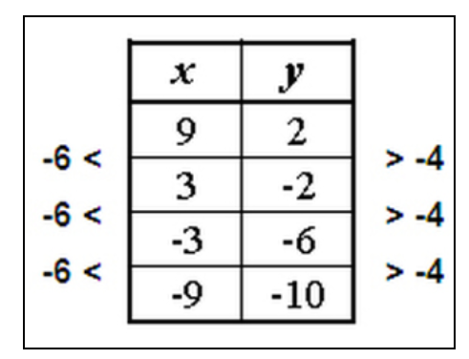
Tables Is this table linear? (Look at the rate of change)

Slide 4
Quadratic = anything that goes into the air (Tables always have a constant 2nd difference)
Transformations
ax² + bx + c = standard form
‘y= (x-h)² + k = vertex form
h= x axis (horizontal shift)
Left to right
k= y axis (vertical Shift)
Height

Slide 5
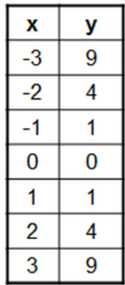
Tables Quadratic tables and rate of change (2nd difference)

Slide 6
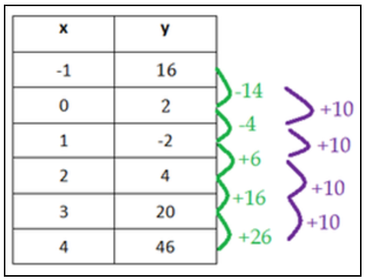
Is this table Quadratic?

Slide 7
Exponential %, Doubling , Tripling, halved
y= a(r) ^{t}
Exponential Growth
y= a(1+r) ^{t}
Exponential decay
y= a(1-r) ^{t}
*a= Initial amount/ Starting Point
^{*r= Rate}
^{*t= time}

Slide 8
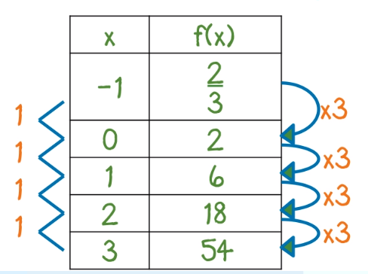
Exponential tables and rate of change (common ratio or rate)

Slide 9
Real world applications Lets tie it all together
A closet organizer charges $100 initial consultation fee plus $30 per hour. The cost as a function of the number of hours worked is graphed below.
Identify the slope and y-intercept and describe their meanings.
The y-intercept is 100. This is the cost for 0 hours, or the initial fee of $100. The slope is 30. This is the rate of change of the cost: $30 per hour.
Find the cost if the organizer works 12 hrs.

Slide 10
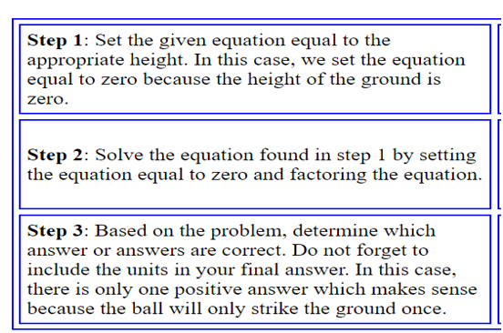
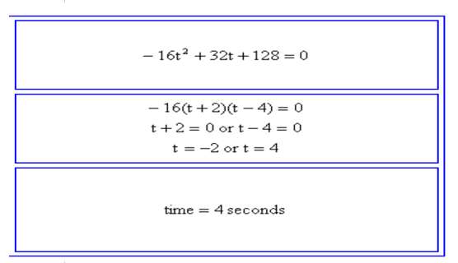
Projectile problems Quadratic

Slide 11
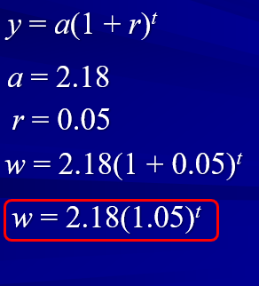
Growth and decay

Slide 12
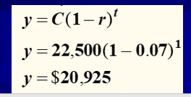
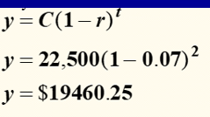
Exponential growth and decay

Slide 13
You Do !!!!! Your Turn ☺

Slide 14
Closing Question Analysis
You purchased a home for the initial price of $142,000 with a 3% monthly interest. In 12 years you have paid a total of $426,000.
Is this final amount after 12 years correct?
Why or why not?
If incorrect please find the correct amount after 12 years.

