Slide 1
OPENING
Classwork form Monday and Tuesday on your desk if you want extra points.
Write the explicit rule/formula for the sequence:
$$2 , 6 , 18 , 54 , …$$
3) The first term of a geometric sequence is -3, and the common ratio is -2. What is the 9th term?

Slide 2
Practice Questions???

Slide 3
Characteristics of Exponential Functions

Slide 4
Transformations
$$f\left(x\right)=a{\left(b\right)}^{x−h}+k$$
What does a do?
Reflect across the x-axis (-a)
Vertical stretch (a > 1)
Vertical shrink (0 < a < 1)
What does h do?
Moves left (+h)
Moves right (-h)
What does k do?
Moves up (+k)
Moves down (-k)

Slide 5
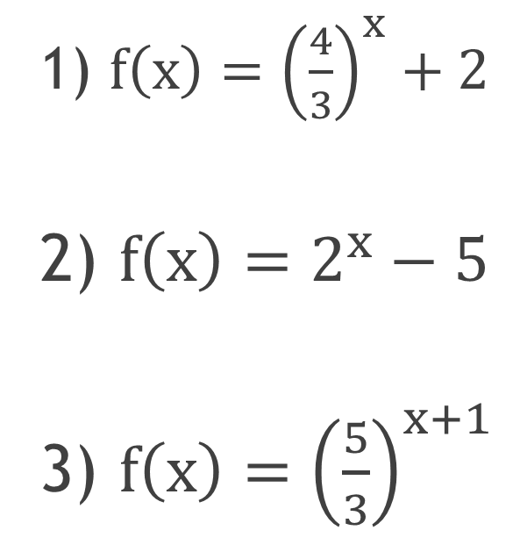
Describe the transformation.
1) $f\left(x\right)={\left(\frac{4}{3}\right)}^{x}+2$
2) $f\left(x\right)=2^{x}−5$
3) $f\left(x\right)={\left(\frac{5}{3}\right)}^{x+1}$
Up 2
Down 5
Left 1

Slide 6
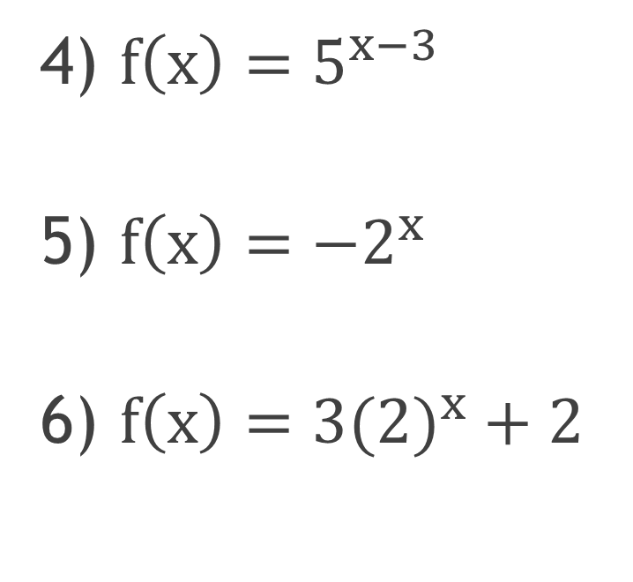
Describe the transformation.
Right 3
Reflect across the x – axis (flips)
Up 2
Stretch 3
4) $f\left(x\right)=5^{x−3}$
5) $f\left(x\right)={−2}^{x}$
6) $f\left(x\right)={3(2)}^{x}+2$

Slide 7
Domain
and
Range

Slide 8
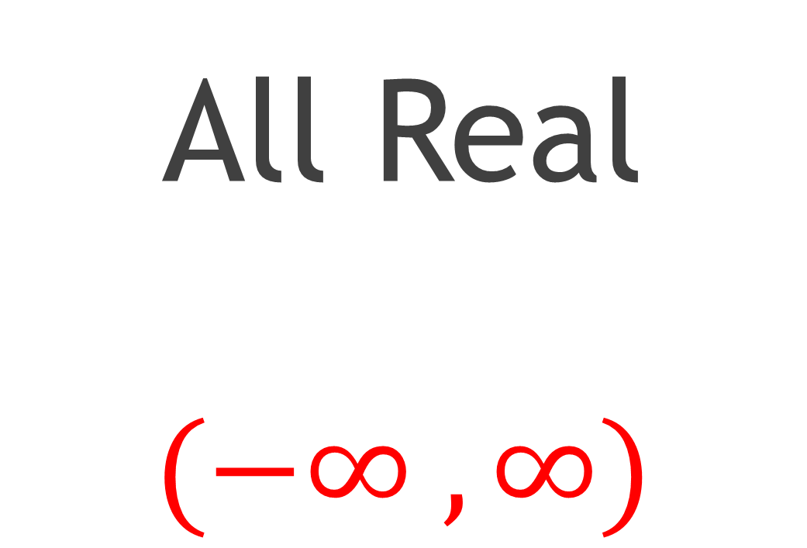
Domain
All Real
$$(−∞ , ∞)$$

Slide 9
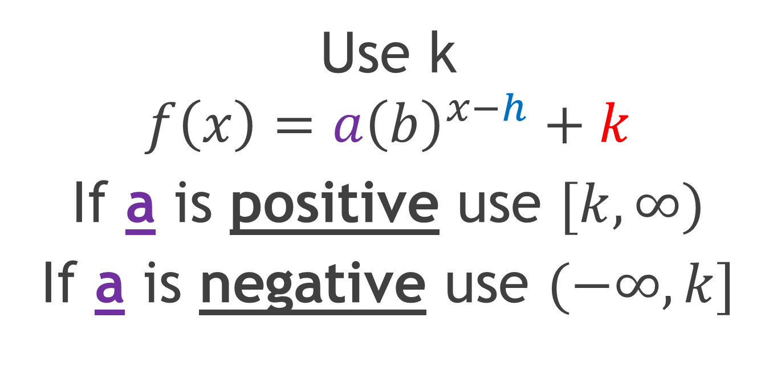
Range
Use k
$$f\left(x\right)=a{\left(b\right)}^{x−h}+k$$
If a is positive use $[k,∞)$
If a is negative use $(−∞,k]$

Slide 10

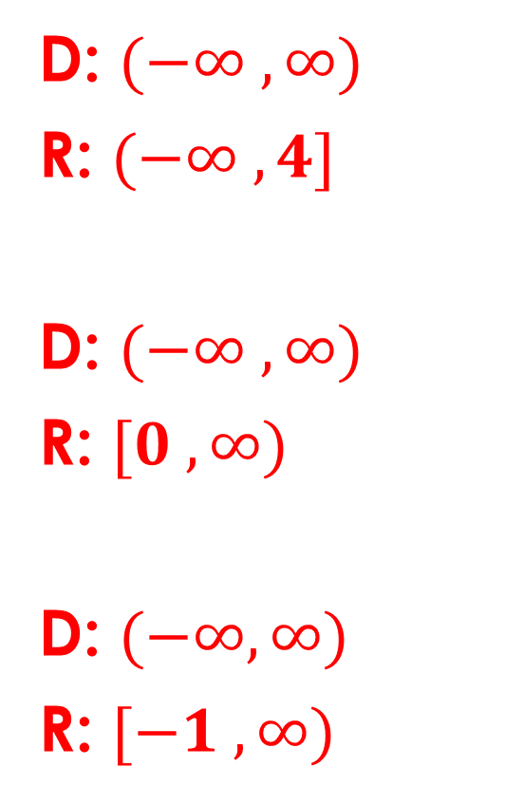
Identify the domain and range.
D: $(−∞ , ∞)$
R: $(−∞ , 4]$
D: $(−∞ , ∞)$
R: $[0 , ∞)$
D: $(−∞,∞)$
R: $[−1 , ∞)$
7) $f\left(x\right)=−2^{x}+4$
8) $f\left(x\right)={3(2)}^{x}$
9) $f\left(x\right)=4^{x+3}−1$

Slide 11
Asymptote
$$y=k$$
A line that a graph approaches but will never touch
Horizontal, Dashed line
$$f\left(x\right)=a{\left(b\right)}^{x−h}+k$$

Slide 12
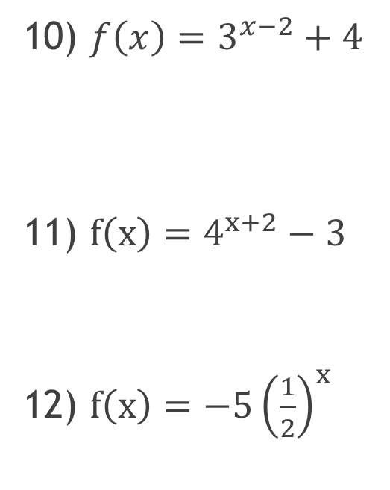
Identify the asymptote of the graph of the function.
y = 4
y = -3
y = 0 the x – axis
10) $f\left(x\right)=3^{x−2}+4$
11) $f\left(x\right)=4^{x+2}−3$
12) $f\left(x\right)=−5{\left(\frac{1}{2}\right)}^{x}$

Slide 13
Intercepts
x – intercept
(x , 0) – where the graph touches the x – axis
y – intercept
(0 , y) – where the graph touches the y - axis

Slide 14
Read from left to Right
Increasing
up from left to right
Decreasing
down from left to right

Slide 15
End Behavior

