Slide 1
Characteristics of Quadratic functions
f(x)= ax² + bx + c
f(x) = a (x – h)² + k

Slide 2
Vocabulary
Parabola: The ____ shaped graph of a quadratic function.
Domain: The set of ___-values of a relation.
Range: The set of ___-values of a relation.
Axis of Symmetry: A _________ line that divides the graph of a function into mirror images.
Vertex: The point on the parabola that lies on the axis of symmetry.

Slide 3
Vocabulary
X-Intercept: The point(s) at which a parabola crosses the ___-axis.
Y-Intercept: The point(s) at which a parabola crosses the ___-axis.
Zero: A value k whereas f(k)=0. (The __-values of the x-intercepts.)
Maximum: The highest ___-value.
Minimum: The lowest ___-value.
***Max. and Min. do not include , or -

Slide 4
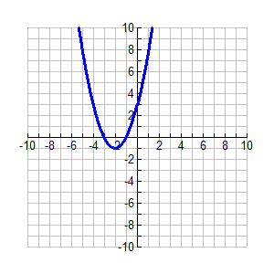
For Example
Domain
Range
AOS | x= -2
Vertex | (-2, -1)
X-intercept(s) | (-3,0) (-1,0)
Y-intercept(s) | (0, 3)
Zero(s) | -3, -1
Maximum | None
Minimum | -1

Slide 5
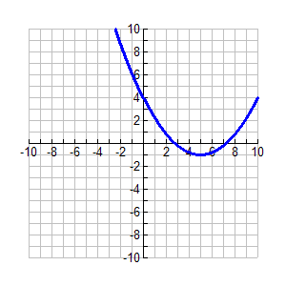
Now you try
Domain
Range
AOS
Vertex
X-intercept(s)
Y-intercept(s)
Zero(s)
Maximum
Minimum

Slide 6
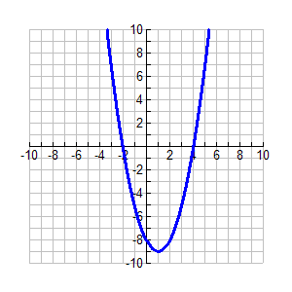
One more
Domain
Range
AOS
Vertex
X-intercept(s)
Y-intercept(s)
Zero(s)
Maximum
Minimum

Slide 10
Increasing and Decreasing: Graph
To find where the graph is increasing and decreasing trace the graph with your finger from left to right. Specify x-values!
If your finger is going up, the graph is increasing.
If your finger is going down, the graph is decreasing.

Slide 18
You try
Think Pair share with your partner
Discuss your thinking and your answers

Slide 19
Standard Form
Standard Form
Domain: All real numbers
Range: [-4-∞ )
X-Intercept (-3,0) & (1,0)
Y- Intercept (0,-3)
AOS = -1
Vertex= (-1,4)
Max/ Min = Max= none
Min = (-1,4)
Increasing: (-4,∞)
Decreasing: (-∞, -4)

Slide 20
Vertex Form
Domain
Range
X-intercept
Y-intercept
AOS
Vertex
Max/Min
Increasing
Decreasing

Slide 22
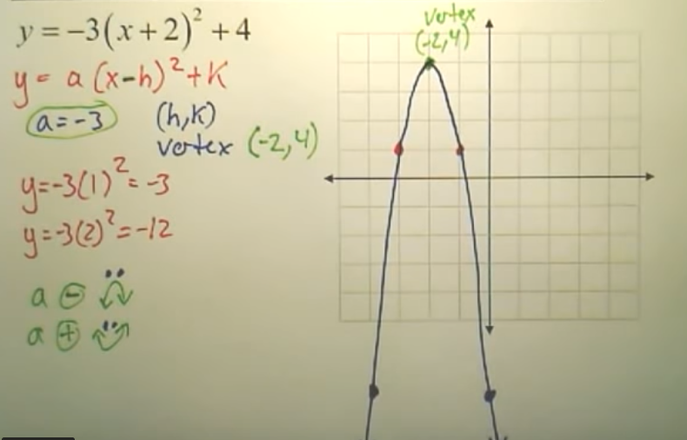

Slide 23
Average Rate of Change
The average range of change between any two points (x₁,f(x₁)) and (x₂,f(x₂)) is the slope of the line through the 2 points.

Slide 24
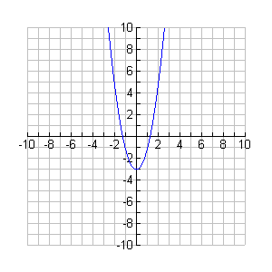
Example 1
Find the average rate of change of f(x) = 2x² – 3 when x₁= 2 and x₂ = 4.

